Slide 1
VTK (Volunteer Tool Kit)
Finance Tab
Troop Leader Training
Revised 9/15/2022.

Slide 2
Goals:
  Overview of Council Troop Finance Procedures
  Step by step training of new finance tab in VTK
  Key Dates

Slide 3
Annual Troop Financial Reporting Procedures

Slide 4
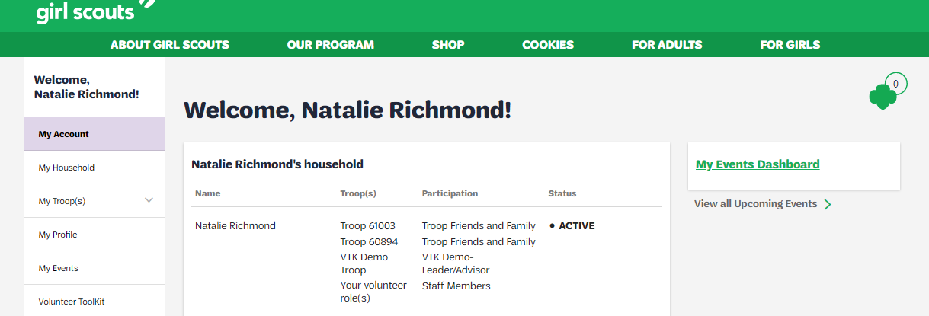
Troop leader Finance tab in THE vtk
Login to your Volunteer Toolkit (VTK) through the MyGS link on your council’s website, click on Volunteer Toolkit

Slide 5
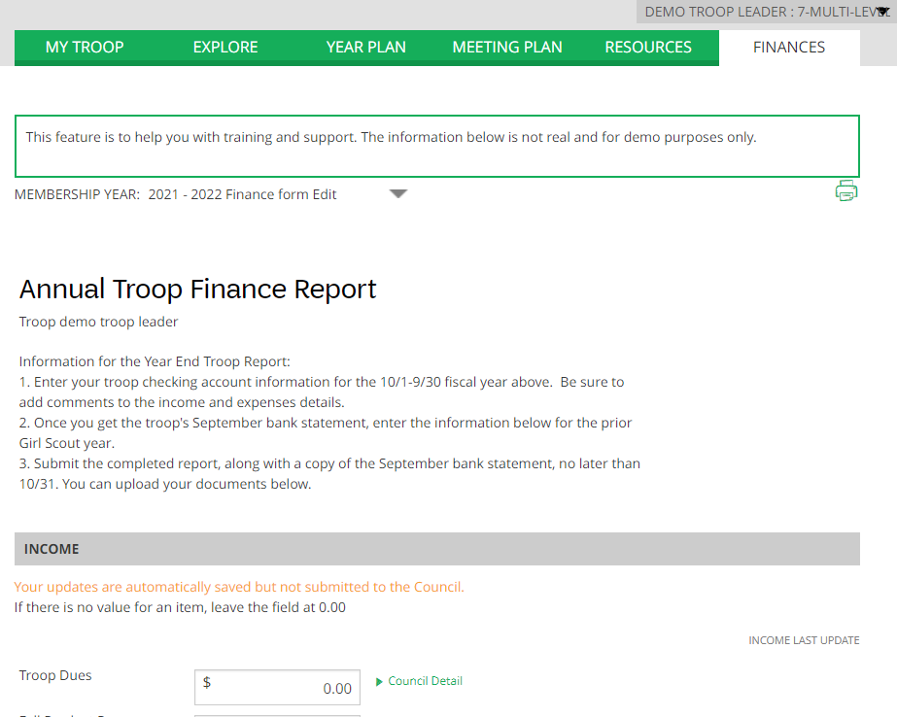
Click on “Finances” tab

Slide 6
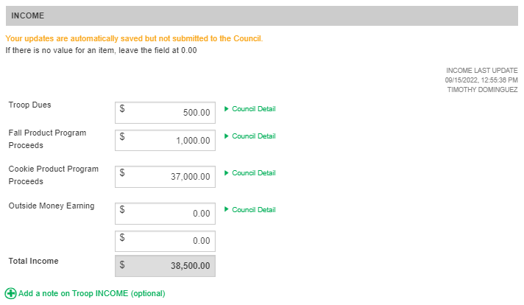
Entering Troop Income
Enter in your troop’s annual income in the provided categories, check for council details by clicking on the green arrows to the right of the income field “council detail” to show an expanded description.
Click the + sign on Add a note (in green) to add additional information
Note: the Last update time stamp will update automatically (the form is auto-saved) – do not enter any special characters, such as commas in the income fields

Slide 7
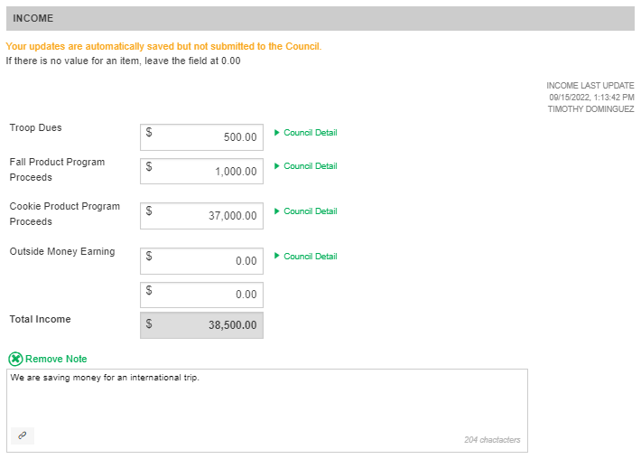
Enter in a council note at the bottom about your troop’s annual income (if needed)
For example: we are saving money for a large trip.

Slide 8
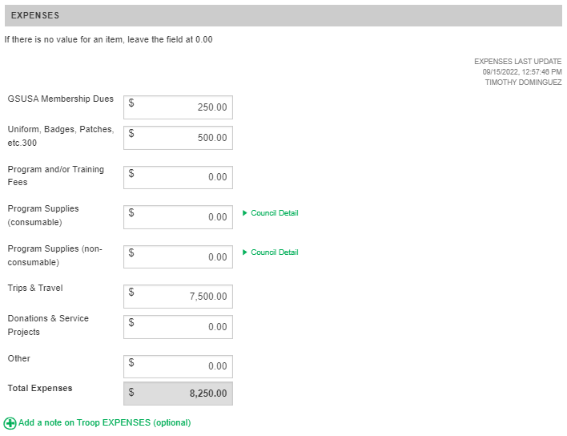
Enter in your troop’s annual expenses in the provided categories, check for council details by clicking on the green arrows to the right of the income field “council detail” to show an expanded description.
Click the + sign on Add a note (in green) to add additional information
Note: the Last Update time stamp will update automatically (the form is auto-saved) – do not enter any special characters, such as commas in the expense fields

Slide 9
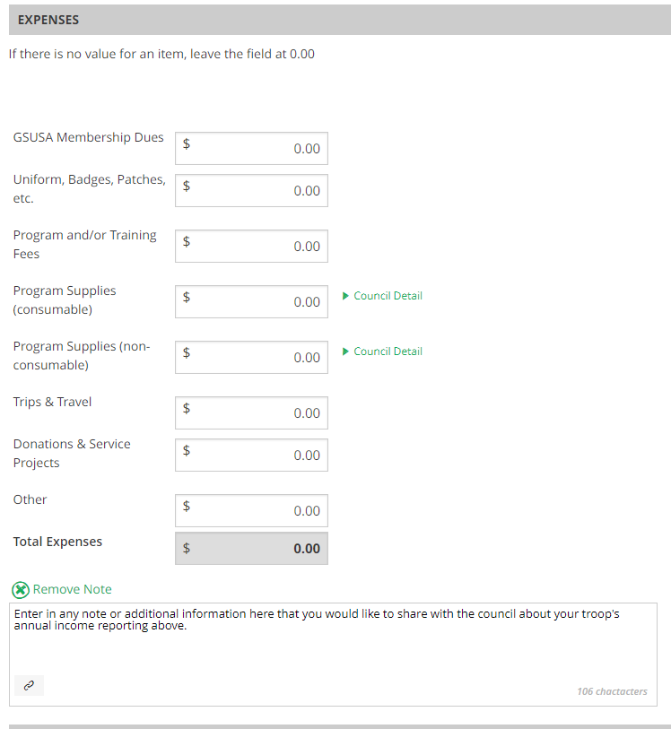
Enter in a council note at the bottom about your expenses (if needed)
Example: we are saving funds for a troop trip.

Slide 10
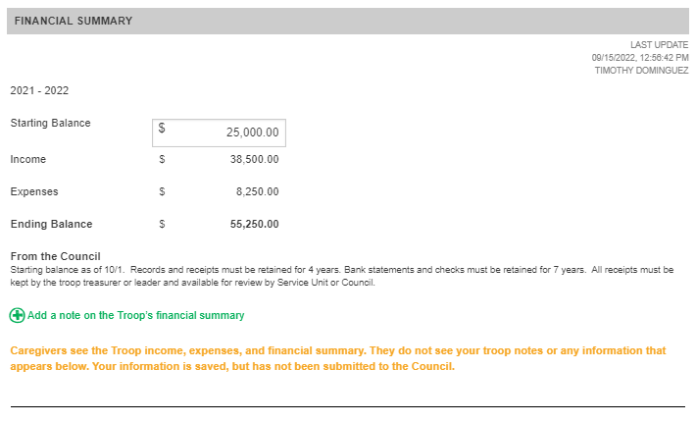
Review your financial summary and look for any instructions from the council here about ending balances.
Enter in a note here to the council

Slide 11
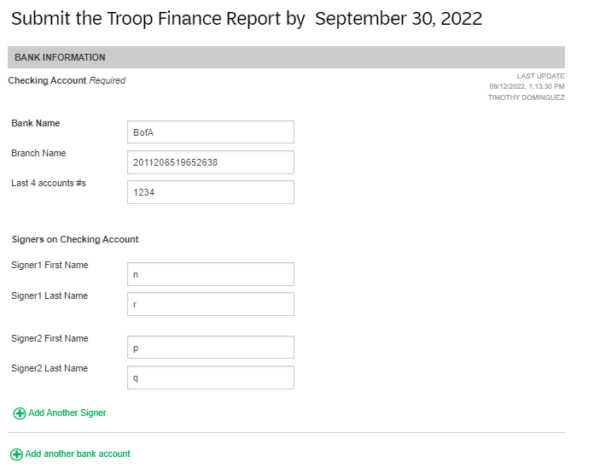
Note the due date of your troop’s finance report here
Enter in your troop banking account information, as well as signers on your account
You can click the + symbol to add another signer and/or bank account

Slide 12
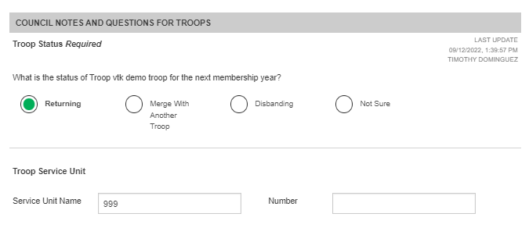
Troop status and Service unit information
Indicate your troop’s status for next year by selecting the appropriate radio button here, as well as enter your Service Unit name & number

Slide 13
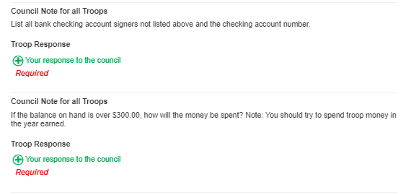
Rate your year’s experience as a troop leader
Right underneath that section, look for any special council notes (information or questions that require responses) from your troop. You will see “Required” in red if you must respond. Click the + Your response to the council to open a text box to enter your response.

Slide 14
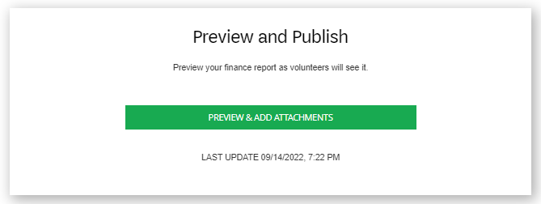
You’re Done Entering Information – It’s time to preview!
Click the green button to preview your finance report on the next page. You’ll be able to edit it again if you need to.
Note the last timestamp reflects when you last updated it

Slide 15
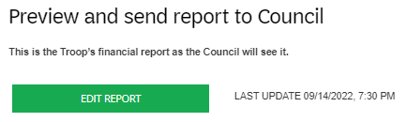
Now you’re in Preview Mode as Troop Leader
Click the Edit Report button at any time to return to editing mode to make changes.

Slide 16
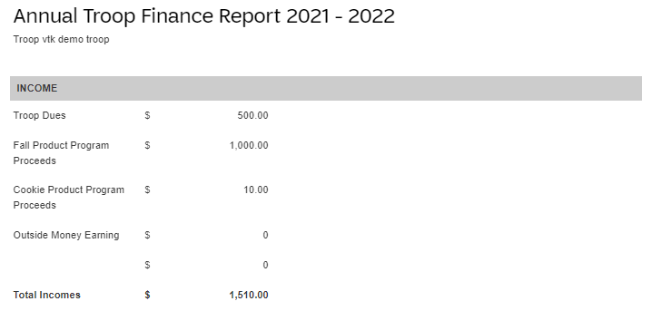
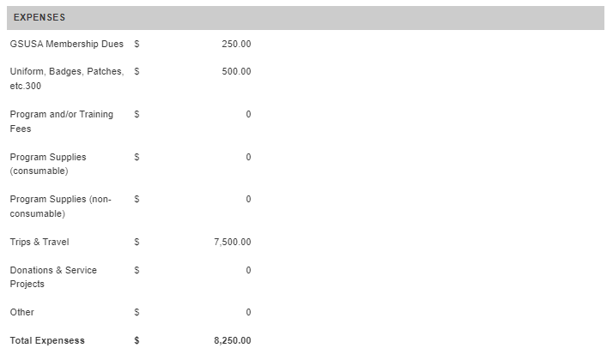
Preview mode:
You will see your troop’s income and expense entries listed here, as well as any notes you entered on the previous page

Slide 17
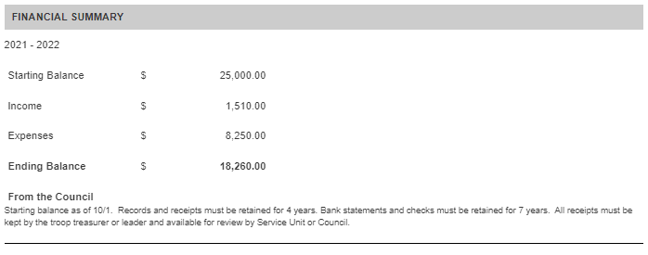
Preview mode: View your troop’s financial summary and any notes you entered on the previous page

Slide 18
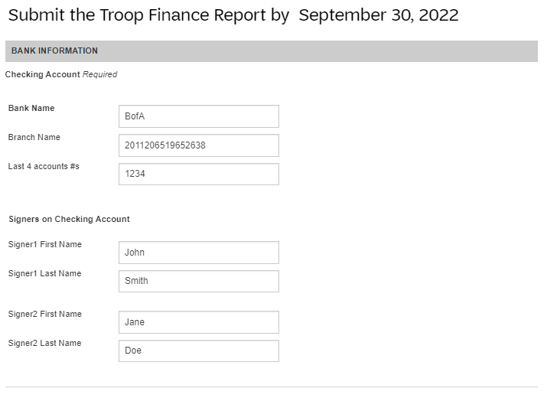
Preview mode: View the bank account and signer information you entered on the previous page

Slide 19
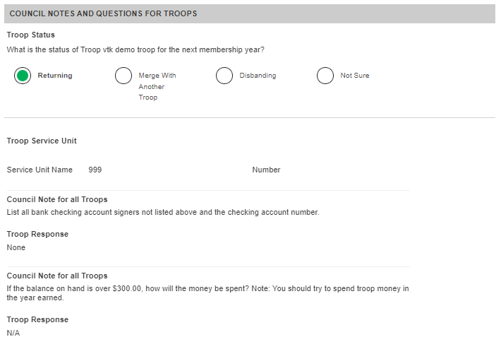
Preview mode: View your troop’s status for the following year
Your Service Unit Name/#
Responses to the council’s questions

Slide 20
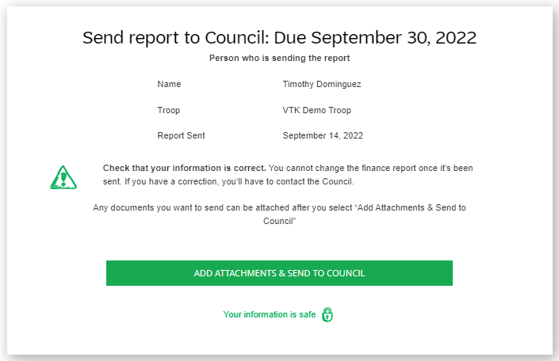
Preview mode: This is the last stop before you send the report to the council. Be sure to check that all information is correct. You can attach documents from your computer after you hit “Add Attachments & Send to Council.”

Slide 21
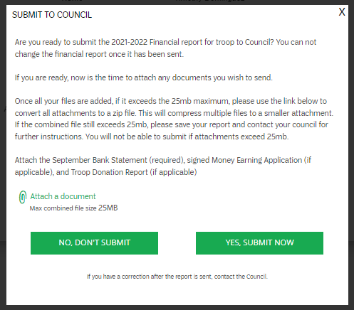
A pop-up window will appear once you hit “Add Attachments & Send to Council” on previous page.
You can click “Attach a document” here to attach any bank statements or required items from the council .
Once you hit “Yes, submit now” to council, you cannot change the finance report information.

Slide 22
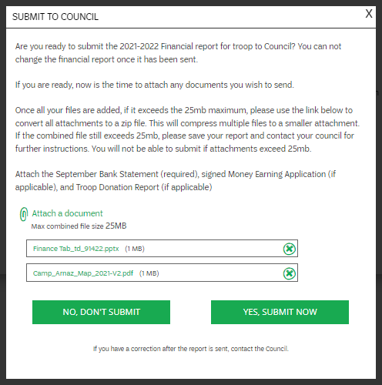
View your attached files here
Click Yes, submit now to submit – or No, don’t submit to go back to preview mode

Slide 23
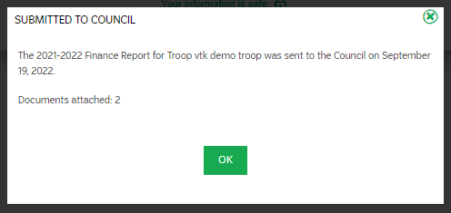
You will receive a pop-up confirmation of your finance report submission
Click Ok to return to your finance tab in the VTK

Slide 24
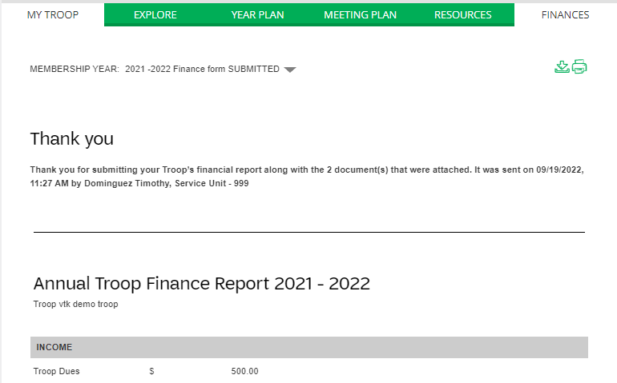
Once back on your finance tab in the VTK, you will see a confirmation message at the top. You will see all of your submitted troop finance information on this page (minus the attached documents).

Slide 25
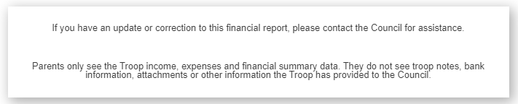
End of Troop Leader View
At the very bottom of the page, you will now see this message

Slide 26
Thank you
Questions or Comments?
800-822-2427
info@girlscoutsccc.org

